Slide 1
THE RISE AND FALL OF NOKIA
Prepared By
Sainath Gagireddy
Ram Pochammala
Siddharth Patel
Sudheer Bangunde
Notes:
Diffused arches
(Intermediate)
To reproduce the shape effects on this slide, do the following:
On the Home tab, in the Slides group, click Layout, and then click Blank.
On the Home tab, in the Drawing group, click Shapes, and then under Lines, click Curve (tenth option from the left).
On the slide, click three points to draw a simple curved line, and then double-click to finish drawing.
Select the curved line. On the Home tab, in the Drawing group, click the arrow next to Shape Fill, point to Gradient, and then click More Gradients. In the Format Shape dialog box, click Fill in the left pane, select Gradient fill in the Fill pane, and then do the following:
In the Type list, select Linear.
Click the button next to Direction, and then click Linear Down (first row, second option from the left).
Under Gradient stops, click Add gradient stop or Remove gradient stop until two stops appear in the slider.
Also under Gradient stops, customize the gradient stops that you added as follows:
Select the first stop in the slider, and then do the following:
In the Position box, enter 0%.
Click the button next to Color, and then under Theme Colors click White, Background 1 (first row, first option from the left).
In the Transparency box, enter 50%.
Select the second stop in the slider, and then do the following:
In the Position box, enter 100%.
Click the button next to Color, and then under Theme Colors click White, Background 1 (first row, first option from the left).
In the Transparency box, enter 100%.
On the Home tab, in the Drawing group, click Shape Effects, point to Soft Edges, and then click 5 point.
On the Home tab, in the Drawing group, click the arrow next to Shape Outline, and then click No Outline.
To reproduce the background effects on this slide, do the following:
Right-click the slide background area, and then click Format Background. In the Format Background dialog box, click Fill in the left pane, select Gradient fill in the right pane, and then do the following:
In the Type list, select Radial.
Click the button next to Direction, and then click From Center (third option from the left).
Under Gradient stops, click Add gradient stop or Remove gradient stop until two stops appear in the slider
Also under Gradient stops, customize the gradient stops that you added as follows:
Select the first stop in the slider, and then do the following:
In the Position box, enter 0%.
Click the button next to Color, and then under Theme Colors click White, Background 1 (first row, first option from the left).
Select the second stop in the slider, and then do the following:
In the Position box, enter 100%.
Click the button next to Color, and then under Theme Colors click White, Background 1, Darker 50% (sixth row, first option from the left).
To reproduce the duplicate curved lines on the slide, do the following:
On the Home tab, in the Clipboard group, click the arrow under Copy, and then click Duplicate. Repeat the process for a total of three curved lines.
On the slide, drag the curved lines to position them as needed.
Right-click one of the duplicate curved lines, click Edit Points, and then drag the points on the curve to make a new shape. Repeat the process with the other duplicate curved line.

Slide 2
Table of Contents
Introduction
Nokia’s Notable Achievement
Nokia’s Technology Achievement
Nokia Burning Platform
Sales Report Analysis
Apple is not a Competitor
Nokia’s Target
Nokia Too Late
Effect of Android

Slide 3
Introduction
Nokia is one of the most renowned companies in the world that manufactures mobile handsets for a considerable period of time.
Nokia was the world leader in mobile telephones, from 1998, before its decline in 2012.
What were the reasons for this decline and why did a company that was in such a commanding position make such decisions which led to their decline?
Let us begin by looking at some of the facts surrounding Nokia.

Slide 4
Nokia Notable Achievements
1912 | Nokia entered in electronics and Cable market.
1979 | Nokia created radio, telephone company Mobira Oy as joint venture with Finnish TV maker Salora
1981-84 | Launch Nordic Mobile Telephone service, the Mobira Senator, the Mobira Talkman – car phones, Nokia DX200 first Digital switch.
1987 | Mobira Cityman- The Gorba. First hand held mobile phone.
1991-1992 | GSM installed with Nokia Equipment. Nokia launched 1011-first GSM phone.
1998 | Nokia becomes world leader in mobile phones market.
1999-2004 | Nokia Launches Phones with camera, video capability, touch screen, Internet access,

Slide 5
Nokia’s Technology Success
Company’s around the follow the model set by Nokia.
  Sell the phones using phone carriers.
  "Software is also as important as hardware in phone business.“
  Phone can be much more than communication device.
  Nokia had created Product Obsolescence.
Nokia created first successful mobile platform as Symbian.
In future Nokia became the first company to create the tablet with internet in it.
Nokia was also the first company to provide online music using phones and third party as online provider again not apple.
Nokia also created phone with touch screen.

Slide 6
Nokia Burning Platform
In 2010-11, Nokia’s new CEO Stephen Elop wrote an email to all of its employees named “Burning Platform”.
Competitors such as the iPhone and Android-based devices are posing a serious challenge to Nokia's future. It appoints former Microsoft man Stephen Elop as president and chief executive. Nokia cuts a further 1,800 jobs despite a rise in profits.
Nokia announces a strategic partnership with Microsoft days later to compete with Apple and Google's Android platform. Nokia cuts a further 4,000 jobs worldwide from its 65,000-strong workforce.
In 2013, Nokia returns to profit after an 18-month spell of losses. Microsoft buys Nokia's handset business for €5.44bn.

Slide 7
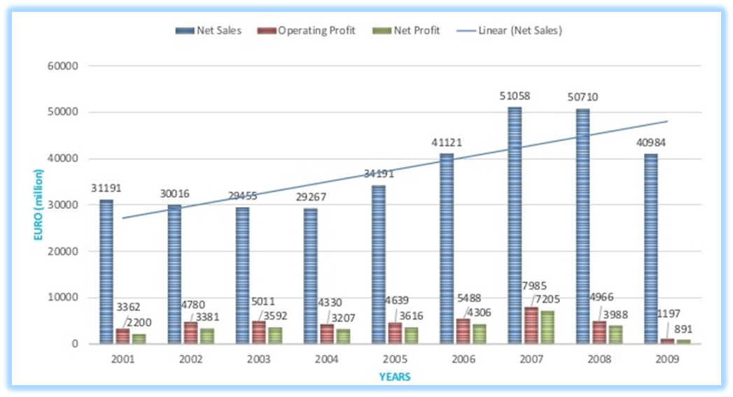
Sales Reports Analysis
As we can see Nokia had a steady raise in the net sales, operating profits and net profits from 2004 -07.
You can see 2009 even Nokia had good sales profit was at bottom low. Hence the ‘Burning platform Email’.

Slide 8
Apple is not Competitor
In 2007, Apple announces iPhone to be launch in 2008.
In response Nokia, does not consider Apple a competition as the iPhone is a luxury phone while Nokia will produce more cheap phones.
Nokia decide to gain 40% market share with cheap phones in new markets as India, China, Russia, and Africa.
Nokia decide to stay with its famous and proven software Symbian OS.
While Motorola is changing this strategy by creating phones more stylish and luxuries modes like Moto Razor.

Slide 9
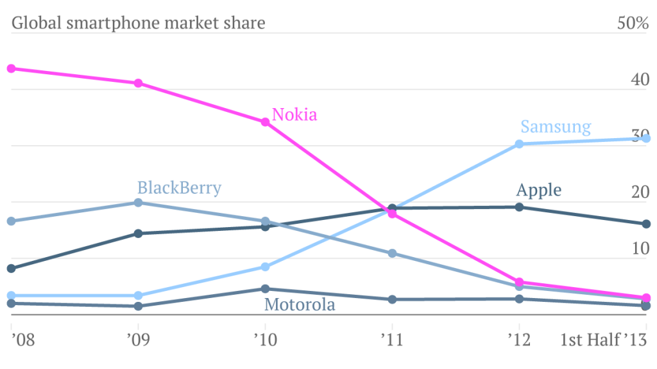
Nokia’s Target
In 2007-8 Nokia’s target to reach 40% global market share was successfully achieved.
Because of the cheap phones Nokia lost North America and decline in Europe.

Slide 10
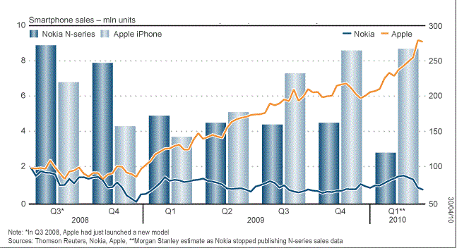
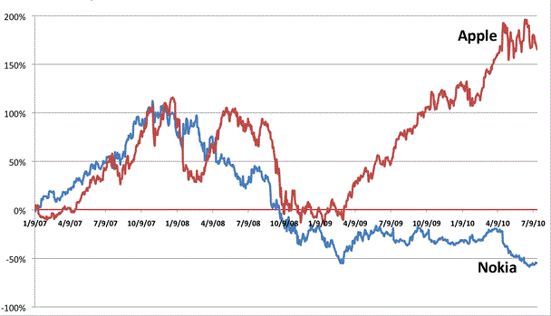
Nokia too late
2009, Nokia consider Apple a competition. As Nokia’s N series mobile phones, high-end mobile phones sells declined.
Apple’s share prices increased steadily after 2009 and during this period Nokia’s stock prices deceased considerably

Slide 11
Effect of Android
In 2007, Google launched Android and started an Open Handset Alliance.
Motorola, Samsung ,HTC, Sony and many other company struggling at the time
joined. And started manufacturing Smartphones with Android.
Nokia, blackberry and Apple trusted their software and OS and decide not to join the alliance.
With the other company's in the market the phone keep getting cheaper and cheaper and this commoditize mobile/smart phone market.
Profits in cheap mobile market keep getting reduced. Hence , In 2009, Nokia had good sale, and 40% market share but Nokia didn’t make big any profits.

Slide 12
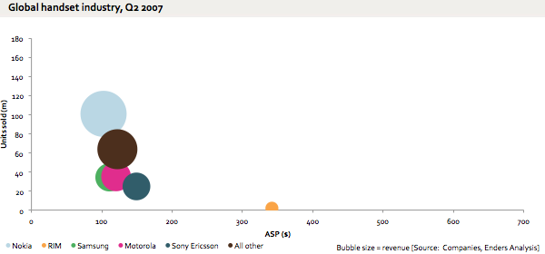
Market Change
Average Selling Price for per hand set and revenue.
As Nokia was more selling its product in China, India, Africa and Mobile Phone was not saturated.

Slide 13
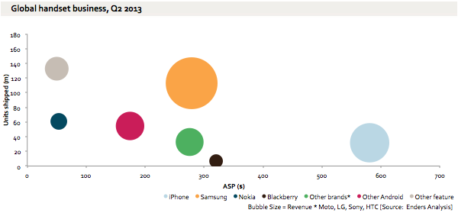
In 2013, Market was changed. IPhone was making most money with luxury phones.
And Samsung,HTC,LG and Sony was also making more money with more costly phone compare to Nokia.
commoditize

Slide 14
2011, Nokia Windows phone
Burning platform –Email. Explains the faults in the Nokia’s leadership and says either jump in water or go in to the flames.
Nokia joins with Microsoft. Give ups on Symbian OS.
  Microsoft because CEO Elop is Ex Microsoft CEO.
  Nokia’s believe that software was unique and will satisfy its customer base.
  Leadership wanted to sell company to Microsoft in future
  If in 2010 Nokia chooses android is Nokia still alive?

Slide 15
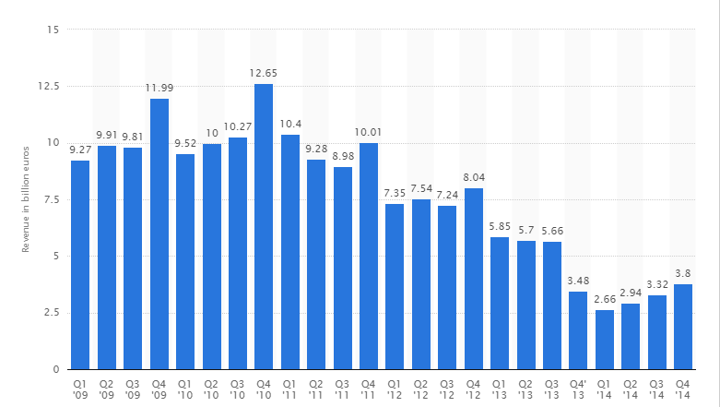
Microsoft buys Nokia
Nokia sales keep getting Lower and lower and Nokia decide to sell its mobile handset business to Microsoft.

Slide 16
Conclusion
Was unable to stay in the competition with Android and iOS devices.
Goal more market share.
Quality/luxury phone Market share was low.
Did not consider Apple to be a competitor until three years after its release.
Going with Microsoft Windows after the failure with Symbian OS.

Slide 17
Thank you

